Slide 2
Micro operations
Digital systems are modular in nature, with modules containing registers, decoders, arithmetic elements, control logic, etc.
These digital components are defined by the registers that they contain and the operations performed on their data. These operations are called micro operations.
Micro operations are elementary operations performed on the information stored in one or more registers.

Slide 3
Micro operations are classified into four categories:
– Register transfer micro operations (data moves from register to register)
– Arithmetic micro operations (perform arithmetic on data in registers)
– Logic micro operations (perform bit manipulation on data in registers)
– Shift micro operations (perform shift on data in registers)

Slide 4
Arithmetic Microoperations
Unlike register transfer microoperations, arithmetic microoperations change the information content.
The basic arithmetic microoperations are:
addition
subtraction
increment
decrement
shift

Slide 5
Arithmetic Microoperations (continued)
• The RTL statement:
R3←R1+R2
indicates an add microoperation. We can similarly specify the other arithmetic microoperations.
Multiplication and division are not considered microoperations.
– Multiplication is implemented by a sequence of adds and shifts.
– Division is implemented by a sequence of subtracts and shifts.

Slide 6
Arithmetic Microoperations
Symbolic Designation | Description
R3 ←R1+R2 | Contents of R1 plus R2 transferred to R3
R3 ←R1–R2 | Contents of R1 minus R2 transferred to R3
R2 ← R2’ | Complement contents of R2 (1’s comp.)
R2 ← R2’ + 1 | 2’s complment contens of R2 (negate)
R3 ← R1+R2’ + 1 | R1 plus 2’s comp. of R2
R1 ← R1 + 1 | Increment content of R1 by 1
R1 ← R1 - 1 | Decrement content of R1 by 1

Slide 7
Binary Adder
We implement a binary adder with registers to hold the data and a digital circuit to perform the addition (called a binary adder).
The binary adders is constructed using full adders connected in cascade so that the carry produced by one full adder becomes an input for the next.
Adding two n-bit numbers requires n full adders.
The n data bits for A and B might come from R1 and R2 respectively

Slide 8
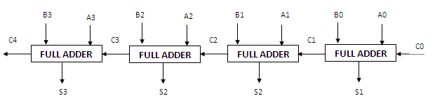
4-Bit Binary Adder

Slide 9
Adder-Subtracter
Subtracting A – B is most easily done by adding B’ to A and then adding 1.
This makes it convenient to combine both addition and subtraction into one circuit, called an adder-subtracter.
M is the mode indicator
– M = 0 indicates addition (B is left alone and C₀ is 0)
– M = 1 indicates subtraction (B is complement and C₀ is 1).

Slide 10
each XOR gate receives input M and one of the inputs B. When M=0 we have B XOR 0 = B. when M=1, we have B XOR 1 =B’ and C0=1.

Slide 11
Increment microoperation :
This microoperation increments the one value of register.
For example:- R1 <- R1+1
Binary incrementer
The binary incrementer adds 1 to the contents of a register, e.g., a register storing 0101 would have 0110 in it after being incremented.
There are times when we want incrementing done independent of a register. We can accomplish this with a series of cascading half-adders.

Slide 12
The circuit receives the four bits A0 to A3 adds one to it and generates the incremented output S0 through S3.

Slide 13
Decrement Microoperation: This microoperation decrement one values from value of register.
For example: R1 ← R1-1

Slide 14
Logic Microoperations
Logic microoperations are binary operations performed on corresponding bits of two bit strings.
Example: P: R1 ← R1 ⊕ R2
1010 Content of R1
1100 Content of R2
0110 Content of R1 after P = 1
Special Symbols used for logic operations:
∧- AND ∨- OR ⊕- XOR

Slide 15
Logic micro operations are bit-wise operations, i.e., they work on the individual bits of data.
useful for bit manipulations on binary data.
useful for making logical decisions based on the bit value

Slide 16
16 different logic operations with 2 binary vars.
Truth tables for 16 functions of 2 variables and the corresponding 16 logic micro-operations.

Slide 17
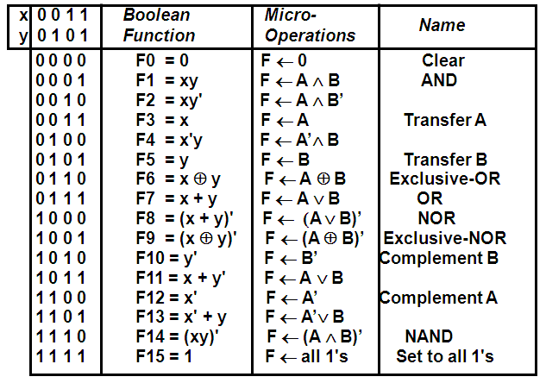

Slide 18
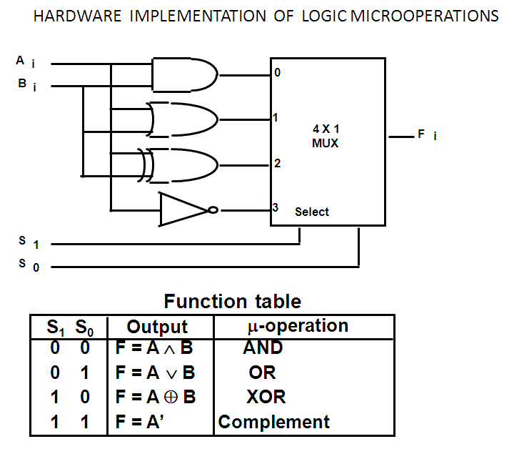
Draw a combinational circuit that perform four logical micro operations.

Slide 19
Shift micro operations
Shift micro operations are used for serial transfer of data.
This operations shift contents of register in left or right direction.
At the same time when the bits are shifted the last or flip-flop receives binary information from serial inputs.
There are three types of shift operations:
Logical shift micro operation.
Circular shift micro operation
Arithmetic Shift micro operation

Slide 20
Symbolic Designation | Description
R ← shl R | Shift-left register R
R ← shr R | Shift-right register R
R ← cil R | Circular shift-left register R
R ← cir R | Circular shift-right register R
R ← ashl R | Arithmetic Shift-left register R
R ← ashr R | Arithmetic Shift-right register R

Slide 21
Logical Shift
The standard logical shifts shift all bits one bit position to the left or right and place a 0 in the leftmost or rightmost position, respectively.
It can be defined in RTL by:
R←shl R shift-left register R
R←shr R shift-right register R

Slide 22
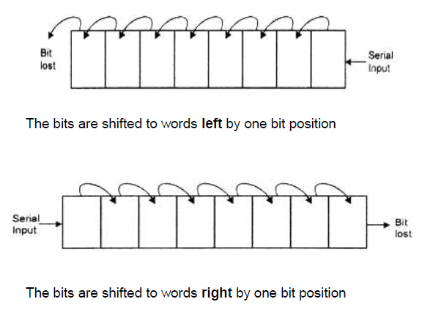
example

Slide 23
Circular shift
The circular shift is also known as Rotate micro operation. It circulates the bit around both ends without any loss of information.
It operate the same as a logical shifts except that instead of shifting a 0 into the end bit, the leftmost bit is shifted into the rightmost bit position on a CIL, and the rightmost bit is shifted into the leftmost bit position on a CIR.
It can be defined in RTL by:
R←cil l circular shift-left register R
R←cir r circular shift-right register R

Slide 24
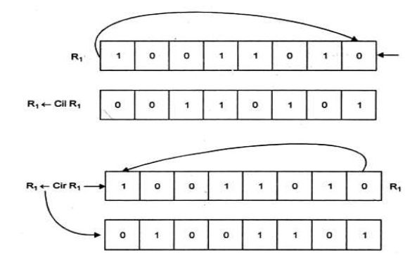
Circular shift

Slide 25
Arithmetic shift
The arithmetic shift shifts a signed binary number to the left or right
To the left is multiplying by 2, to the right is dividing by 2
Arithmetic shifts must leave the sign bit unchanged
Because the sign of the number remain same when it multiplied or divided by 2.
The left bit hold the sign bit and others hold number
The sign bit 0 for positive and 1 for negative
It can be defined in RTL by:
R←ashl l arithmetic shift-left register R
R←ashr r arithmetic shift-right register R

Slide 26
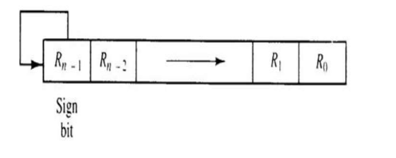

Slide 27
The basic computer has three instruction code formats:
1. Register Reference instruction
2. Memory Reference instructions
3. Input –output instruction

Slide 29
A memory-reference instruction
Refers to memory address as an operand. the operand is always accumulator.
Specifies 12 bit address,3 bit opcode(other than 111) and 1bit addressing mode for direct and indirect addressing.
Register reference instructions
are recognized by the operation code 111 with a 0 in the leftmost bit (bit 15) of the instruction

Slide 30
Input –output Instruction:
An input-output instruction does not need a reference to memory and is recognized by the operation code 111 with a 1 in the leftmost bit of the instruction.
The remaining 12 bits are used to specify the type of input-output operation or test performed

Slide 31
INSTRUCTION CYCLE:
In the basic computer each instruction cycle consists of the following phases:
Fetch an instruction from memory.
Decode the instruction.
Read the effective address from memory if the instruction has an indirect address.

Slide 32
d) Execute the instruction
After step d, the control goes back to step 1 to fetch, decode and execute the next instruction.
This process continues unless a HALT instruction is encountered.

Slide 33
1. FETCH AN INSTRUCTION FROM THE MEMORY
Initially PC is loaded with the address of the first instruction of the program.
The sequence counter (SC) is cleared to 0.after each clock pulse , SC is incremented by one , so that the timing signals go through a sequence T₀,T₁,T_{2,} and so on.
T₀:AR← PC
T₁:IR←M[AR],PC ←PC+1

Slide 34
(2) Decode the Instruction:
The fetched instructions are decoded at time T2,which can be specified with the microoperation.:-
T₂D₀....D₇ ← decode IR [ 12-14 ],
AR ←IR (0-11),
I ←IR(15)

Slide 35
(3) Read Effective Address:
D₇’I’T₃ : AR ←M[AR]
Other instruction are identified with the specified control function and executed.
D₇’I’T₃: nothing
D₇I’T₃: execute register –reference instruction
D₇IT₃: execute an input –output instruction

Slide 36
(4) Execute the instruction:
After fetching the indirect address from the memory, instructions are executed .
SC is initialized with 0 sign and control is passed to the first step.
This process continues unless a HALT instruction is encountered.

Slide 37
Types of Instruction:
There are three types of instructions:
1. Memory Reference instructions
2. Register Reference instruction
3. Input –output instruction

Slide 38
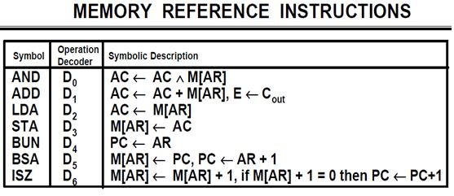
(1) Memory Reference Instructions:
An instruction which has operation code D7=000 to 110 and i=1 or 0 then it is called memory –reference instructions.

Slide 39
Register –Reference Instruction:-
Instruction which has operation code D7=111 and i=0 then it is called as register –reference instruction
The first seven register-reference instructions perform clear, complement, circular shift, and increment microoperation in the AC or E registers.
The next four register cause a skip of the next instruction in sequence when a stated condition is satisfied.

Slide 40
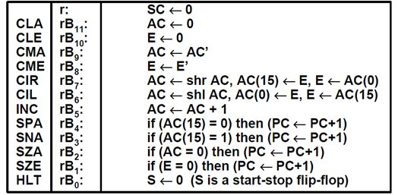

Slide 41
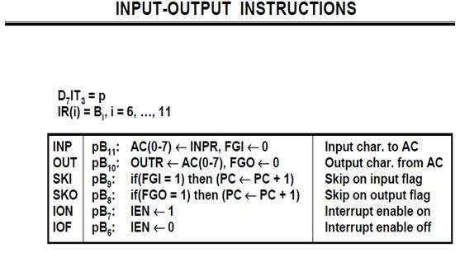
(3) Input –output Instruction :- input-output instructions have an operation code 1111 and are recognized by the control when D7=1 and I=1

Slide 42
REGISTER TRANSFER LANGUAGE
A Language in which the symbolic notation is used to describe the micro operation transfer among registers is called a register transfer language.
‘Register Transfer’ means a logic circuit that performs micro operations and transfer the result of the operation to the same or another register.
A Register transfer language is a system for expressing in symbolic form the micro-operation sequences among the registers of a digital module.

Slide 43
Information transfer from one register to another is designated in symbol form by means of a replacement operator in the statement.
R2 ← R1
Denotes the transfer of the content of register R1 into register R2. By definition the content of the source register R1 does not change after the transfer.

Slide 44
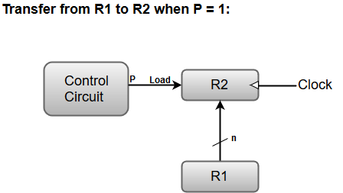
Normally we want the transfer to occur only under a predetermined control condition. This can be shown by means of an If than statement
If (P=1) than ( R2 ← R1)
Where p is a control function which is a Boolean variable that is equal to 1 or 0 the control function in the statement as follows
P: R2 ← R1

Slide 45
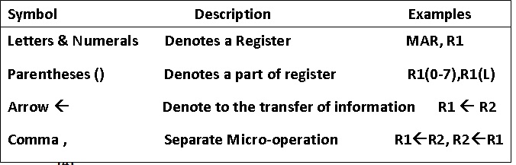
Symbols of Register Transfer : Some symbols are used in Register Transfer Language to describe the expression.

Slide 46
BUS TRANSFER
A BUS is the set of common lines (wires) in which each line is used for one bit of the register through which binary information is transferred at a time.
A digital computer has many registers and path must be provided to transfer information from one register to another.

Slide 47
The number of wires will be increased if separate lines are used between each register and all the other registers in the system.
A more efficient scheme for transferring information between registers in a multiple register configuration in a common bus system.
The bus structure contains of a set of common lines one for each bits of a register, through which binary information is transferred one at a time.

Slide 48
There are two ways to construct common bus systems
With the help of multiplexer
With three state bus buffers

Slide 49
The multiplexers select the source register whose binary information is then placed on the bus.
Each register has four bits, numbered 0 through 3.
The bus consists of four 4 x 1 multiplexers each having four data inputs, 0 through 3, and two selection inputs, S1 and S0.
These two selection lines S1 and S0 are connected to the selection inputs of all four multiplexers.

Slide 50
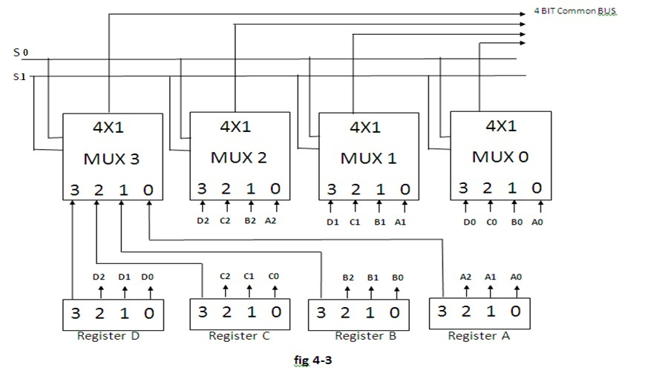

Slide 51
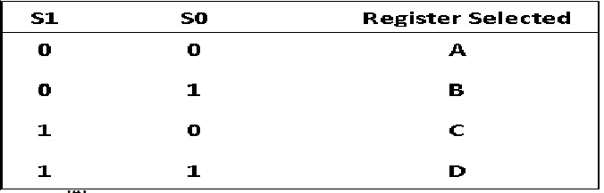
The selection lines choose the four bits of one register and transfer them into the four- line common bus.

Slide 52
When S1S0 = 00, the 0 data inputs of all four multiplexers are selected and applied to the outputs that form the bus.
This causes the bus lines to receive the content of register A since the outputs of this register are connected to the 0 data inputs of the multiplexers.
Similarly, register B is selected if S1S0 = 01, and so on.

Slide 53
A bus system will multiplex k registers of n bits each to produce an n-line common bus.
The number of multiplexers needed to construct the bus is equal to n, the number of bits in each register.
The size of each multiplexer must be K x 1 since it multiplexes K data lines.

Slide 54
Number of mux = Number of bits in the register.
Number of inputs in Mux = Number of registers.

Slide 55
Question
For a common bus for eight registers of 16 bits each requires how many mux?
For a common bus system for eight registers what size of mux is required? And what number of selection lines are required?

Slide 56
Ans
For instance, a common bus for eight registers of 16 bits each requires 16 multiplexers, one for each line in the bus. Each multiplexer must have eight data input lines and three selection lines to multiplex one significant bit in the eight registers.

Slide 57
Question
A digital computer has a common bus system of 32 registers of 64 bits each. The bus is constructed with multiplexer.
a) How many selection inputs are there in each multiplexer?
b) What size of multiplexers are needed?
c) How many multiplexers are there in the bus?

Slide 58
Ans
(a) 5 selection lines to select one of 32 registers.
(b) 32 × 1 multiplexers.
(c) 64 multiplexers, one for each bit of the registers.

Slide 59
MEMORY TRANSFER
Read Operation: The transfer of information from a memory word to the outside environment is called a read operation.
Write Operation: The transfer of new information to be stored into the memory is called a write operation.
A memory word will be symbolized by the letter M.
This will be done by enclosing the address in square brackets following the letter M.

Slide 60
Memory Read: Consider a memory unit that receives the address from a register, called a register denoted by AR. The data are transferred to another register called data register denoted by DR. The read operation can be stated as follows:-
Read: DR ← M[AR]
This causes a transfer of information into DR from word M selected by the address in AR.

Slide 61
Memory Write: The write operation transfers the content of a data register to a memory word M selected by the address. Consider that input data are in register R1 and address is in AR. The write operation can be stated symbolically as follows:
Write: M[AR] ← R1
This causes a transfer of information from R1 into the memory word M selected by address in AR.

Slide 62
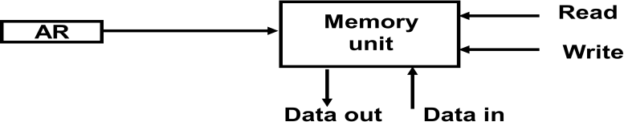

Slide 63
GENERAL REGISTER ORGANIZATION
Generally CPU has seven general registers.
Register organization show how registers are selected and how data flow between register and ALU.
A decoder is used to select a particular register.
The output of each register is connected to two multiplexers to form the two buses A and B.
The selection lines in each multiplexer select the input data for the particular bus.

Slide 64
Clock
Input
R1
R2
R3
R4
R5
R6
R7
Load
(7 lines)
SELA
{
MUX
MUX
}
SELB
3 x 8
A bus
B bus
decoder
SELD
ALU
OPR
Output

Slide 65
The A and B buses form the two inputs of an ALU.
The operation select lines decide the micro operation to be performed by ALU.
The result of the micro operation is available at the output bus.
The output bus connected to the inputs of all registers, thus by selecting a destination register it is possible to store the result in it.

Slide 66
OPERATION OF CONTROL UNIT
The control unit directs the information flow through ALU by:
- Selecting various Components in the system
- Selecting the Function of ALU
Example: R1 <- R2 + R3
[1] MUX A selector (SELA): BUS A ← R2
[2] MUX B selector (SELB): BUS B ← R3
[3] ALU operation selector (OPR): ALU to ADD
[4] Decoder destination selector (SELD): R1 ← Out Bus
3
3
3
5
Control Word
SELA
SELB
SELD
OPR
Encoding of register selection fields
Binary
Code SELA SELB SELD
000 Input Input None
001 R1 R1 R1
010 R2 R2 R2
011 R3 R3 R3
100 R4 R4 R4
101 R5 R5 R5
110 R6 R6 R6
111 R7 R7 R7

Slide 67
ALU CONTROL
Encoding of ALU operations
OPR
Select Operation Symbol
00000 Transfer A TSFA
00001 Increment A INCA
00010 ADD A + B ADD
00101 Subtract A - B SUB
00110 Decrement A DECA
01000 AND A and B AND
01010 OR A and B OR
01100 XOR A and B XOR
01110 Complement A COMA
10000 Shift right A SHRA
11000 Shift left A SHLA
Examples of ALU Microoperations
Symbolic Designation
Microoperation SELA SELB SELD OPR Control Word
R1 ← R2 - R3 R2 R3 R1 SUB 010 011 001 00101
R4 ← R4 ∨ R5 R4 R5 R4 OR 100 101 100 01010
R6 ← R6 + 1 R6 - R6 INCA 110 000 110 00001
R7 ← R1 R1 - R7 TSFA 001 000 111 00000
Output ← R2 R2 - None TSFA 010 000 000 00000
Output ← Input Input - None TSFA 000 000 000 00000
R4 ← shl R4 R4 - R4 SHLA 100 000 100 11000
R5 ← 0 R5 R5 R5 XOR 101 101 101 01100

Slide 68
Stack Organization
A stack is a storage device that stores information in such a manner that the item stored last is the first item retrieved(LIFO).
The register that holds the address for the stack is called a stack pointer (SP) because its value always points at the top item in the stack.
There are two types of stack organization
1.Register Stack-Built using registers
2.Memory Stack-Logical part of memory allocated as stack

Slide 69
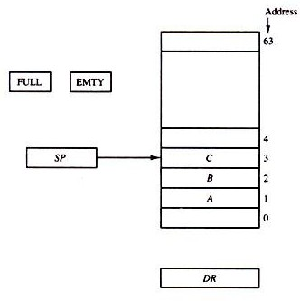
Register Stack

Slide 70
PUSH:
If the stack is not full (FULL =0), a new item is inserted with a push operation. The push operation consists of the following sequences of microoperations:
SP ← SP + 1 Increment stack pointer
M [SP] ← DR Write item on top of the stack
IF (SP = 0) then (FULL ← 1) Check is stack is full
EMTY ← 0 Mark the stack not empty

Slide 71
POP:
A new item is deleted from the stack if the stack is not empty (if EMTY = 0). The pop operation consists of the following sequences of microoperations:
DR ← M [SP] Read item on top of the stack
SP ← SP - 1 Decrement stack pointer
IF (SP = 0) then (EMTY ← 1) Check if stack is empty
FULL ← 0 Mark the stack not full

Slide 72
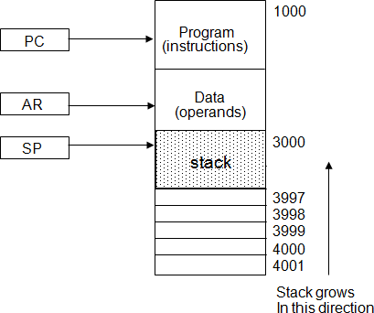
Memory Stack

Slide 73
PUSH
A new item is inserted with the push operation as follows:
SP ← SP - 1
M[SP] ← DR
The stack pointer is decremented so that it points at the address of the next word.
A memory write operation inserts the word from DR into the top of the stack.

Slide 74
POP
A new item is deleted with a pop operation as follows:
DR ← M[SP]
SP ← SP + 1
The top item is read from the stack into DR.
The stack pointer is then incremented to point at the next item in the stack.
The two microoperations needed for either the push or pop are (1) an access to memory through SP, and (2) updating SP.
Which of the two microoperations is done first and whether SP is updated by incrementing or decrementing depends on the organization of the stack.

Slide 75
Reverse Polish Notation(RPN)
The postfix RPN notation, referred to as Reverse Polish Notation (RPN), places the operator after the operands.
The following examples demonstrate the three representations:
A + B Infix notation
+ A B Prefix or Polish notation
A B + Postfix or reverse Polish notation
The reverse Polish notation is in a form suitable for stack manipulation. The expression

Slide 76
A * B + C * D is written in reverse Polish notation as
A B * C D * +
The conversion from infix notation to reverse Polish notation must take into consideration the operational hierarchy adopted for infix notation.
This hierarchy dictates that we first perform all arithmetic inside inner parentheses, then inside outer parentheses, and do multiplication and division operations before addition and subtraction operations.

Slide 77
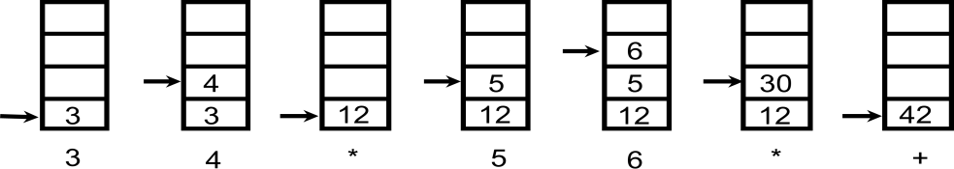
Evaluation of Arithmetic Expressions
Any arithmetic expression can be expressed in parenthesis-free Polish notation, including reverse Polish notation
(3 * 4) + (5 * 6) = 3 4 * 5 6 * +

